Slide 1
Overview of AWS Database Services

Slide 2
What is a Database ?

Slide 3
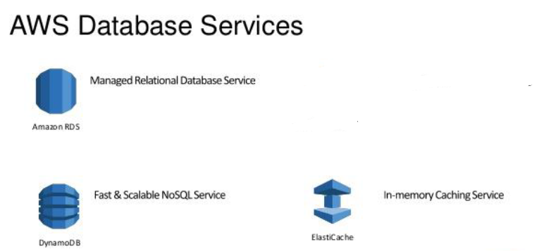
AWS Database Managed Services

Slide 4
What is AWS RDS
Amazon Relational Database Service (Amazon RDS) is a web service that makes it easier to set up, operate, and scale a relational database in the cloud.
Amazon Relational Database Service provides industry-standard relational database.
AWS RDS provides high availability with a primary instance and a synchronous secondary instance that can failover to when problems occur.
AWS RDS database products are:
MySQL
MariaDB
PostgreSQL
Oracle
Microsoft SQL Server
db2
Amazon Aurora DB

Slide 5
AWS RDS: Components
DB
Instances
Security
Groups
Availability
Zone
DB Option
Group
DB Parameter
Group

Slide 6
AWS RDS: Interface
Amazon RDS Console
Command Line Interface
Programmatic Interfaces

Slide 7
AWS RDS: Working with DB Instance
Create
DB Instance
Rename
DB Instance
Reboot
DB Instance
Deleting
DB Instance
Stopping
DB Instance

Slide 8
AWS RDS: Concept
DB Instance Identifier
Master User Account
DB Instance
Class

Slide 9
AWS RDS: Charges
Instance class – Pricing is based on the class
Storage – The storage capacity that you have provisioned to your DB instance
I/O requests per month
Backup Storage
DB | Type | Option | Instance | Region | Price/ Hr.
MS SQL | Standard | Single-AZ | db.m3.medium | N. Virgina | $0.655*
MS SQL | Standard | Multi-AZ | db.m3.medium | N. Virgina | $1.31*
My SQL | - | Single-AZ | db.t2.micro | N. Virgina | $0.017*
My SQL | - | Multi-AZ | db.t2.micro | N. Virgina | $0.034*

Slide 10
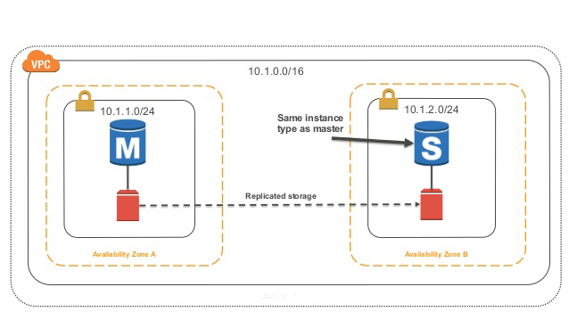
AWS RDS: Multi-AZ
Amazon RDS Multi-AZ deployments provide enhanced availability and durability for Database (DB) Instances.
When you provision a Multi-AZ DB Instance, Amazon RDS automatically creates a primary DB Instance and synchronously replicates the data to a standby instance in a different Availability Zone (AZ).
Each AZ runs on its own physically distinct, independent infrastructure.
Amazon RDS performs an automatic failover to the standby, in case of failure.

Slide 11
AWS RDS Multi-AZ: Benefits
Multi-AZ deployments utilize synchronous physical replication to keep data on the standby up-to-date with the primary.
Multi-AZ provide data redundancy, eliminate I/O freezes, and minimize latency spikes during system backups.
Unlike Single-AZ deployments, I/O activity is not suspended on your primary during backup for Multi-AZ deployments, because the backup is taken from the standby.
If an Availability Zone failure or DB Instance failure occurs, automatic failover takes to complete: typically under two minutes.
DB Instance failover is fully automatic and requires no administrative intervention. Amazon RDS monitors the health of your primary and standbys, and initiates a failover automatically in response to a variety of failure conditions.

Slide 12
AWS RDS Multi-AZ: Failover Process
In the event of a planned or unplanned outage, RDS automatically switches to a standby replica.
Failover times are typically 60-120 seconds. However, large transactions or a lengthy recovery process can increase failover time.
RDS handles failovers automatically so you can resume database operations as quickly as possible without administrative intervention.
The failover mechanism automatically changes the DNS record of the DB instance to point to the standby DB instance. As a result, you will need to re-establish any existing connections to your DB instance.
There are several ways to determine if your Multi-AZ DB instance has failed over:
DB event subscriptions can be setup to notify you via email or SMS that a failover has been initiated.
You can view the current state of your Multi-AZ deployment via the Amazon RDS console and APIs.

Slide 13
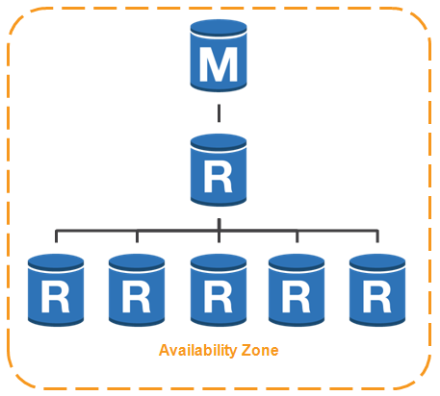
AWS RDS: Read Replica
Amazon RDS uses the MySQL, MariaDB and PostgreSQL DB engines' built-in replication functionality to create a special type of DB instance called a Read Replica from a source DB instance.
You can reduce the load on your source DB instance by routing read queries from your applications to the Read Replica.
Using Read Replicas, you can elastically scale out beyond the capacity constraints of a single DB instance for read-heavy database workloads.
The Read Replica operates as a DB instance that allows only read-only connections.

Slide 14
AWS RDS: Maintenance Window
Every DB instance has a weekly maintenance window during which any system changes are applied. It is initiated during the 30 mnts. maintenance window you identify.
Most maintenance complete during the 30 mnts. maintenance window, but it may take more than 30 mnts.
RDS assigns a 30-minute maintenance window on a randomly selected day of the week, if you don't specify a preferred maintenance window.
Like:
US East (N. Virginia) Region [03:00–11:00 UTC]
Asia Paciﬁc (Mumbai) Region [17:30–01:30 UTC]

Slide 15
AWS RDS: Backup
Amazon RDS creates automated backups of your DB instance during the backup window of your DB instance.
Amazon RDS saves the automated backups of your DB instance according to the backup retention period.
Your DB instance must be in the ACTIVE state for automated backups to occur.
You can also backup your DB instance manually.
Your backup storage is equivalent to the sum of the database storage for all instances.
Automated backups occur daily during the preferred backup window. If the backup requires it continues after the window ends, until it ﬁnishes.

Slide 16
AWS RDS: Restoration
You can create a DB instance by restoring the DB snapshot.
When you restore the DB instance, you provide the name of the DB snapshot to restore from, and then provide a name for the new DB instance that is created from the restore.
You cannot restore from a DB snapshot to an existing DB instance; a new DB instance is created when you restore.
You can restore a DB instance and use a diﬀerent storage type than the source DB snapshot. But, MS SQL DB instance does not support changing the storage conﬁguration when restoring from a DB snapshot

Slide 17
AWS RDS: Copying Snapshot
With Amazon RDS, you can copy DB snapshots.
You can copy automated or manual snapshots.
After you copy a snapshot, the copy is a manual snapshot.
You can copy a snapshot within the same AWS Region or across AWS Regions, and you can copy a snapshot across AWS accounts.
If you want to keep an automated snapshot for a longer period, copy it to create a manual snapshot, which is retained until you delete it.

Slide 18
Overview of Amazon Aurora
Amazon Aurora is a MySQL and PostgreSQL-compatible relational database built for the cloud.
Combines performance and availability of traditional enterprise databases with the simplicity and cost-effectiveness of open source databases.
Distributed, fault-tolerant, self-healing storage system that auto-scales up to 64TB per database instance.
Delivers high performance and availability with up to 15 low-latency read replicas, point-in-time recovery, continuous backup to Amazon S3, and replication across three Availability Zones (AZs).

Slide 19
Aurora DB Replication

Slide 20

Benefits of Amazon Aurora
High Performance and Scalability
High Availability and Durability
Highly Secure
MySQL and PostgreSQL Compatible
Fully Managed
Migration Support

Slide 21
Quiz
1.Does Amazon RDS allow direct host access via Telnet, Secure Shell (SSH), or Windows Remote Desktop Connection?
Yes
No
Depends on if it is in VPC or not
2. A user plans to use RDS as a managed DB platform. Which of the below mentioned features is not supported by RDS?
Automated backup
Automated scaling to manage a higher load
Automated failure detection and recovery
Automated software patching
3. Amazon RDS DB snapshots and automated backups are stored in
Amazon S3
Amazon EBS Volume
Amazon RDS
Amazon EMR

Slide 22
AWS Database Migration(DMS) Service
Replication Instance
Source Endpoint
Target
Endpoint
Tasks

Slide 23
AWS Database Migration Service (DMS) – Overview
AWS Database Migration Service is a web service used to migrate data from On-premises databases, Amazon Relational Database Service (Amazon RDS) DB instance or database running on an Amazon Elastic Compute Cloud (Amazon EC2) instance.
Use the AWS Schema Conversion Tool (AWS SCT) to translate your database schema to the new platform and then use AWS DMS to migrate the data.
AWS DMS & AWS Snowball Edge Integration enables mass Database Migrations and Migrations of large databases.
AWS Migration Hub helps to keep track of the progress of DB Migrations and also provides key metrics .

Slide 24
How is AWS DMS different ?
AWS DMS helps to migrate databases to AWS quickly and securely.
Live Migration : The source database remains fully operational during the migration, minimizing downtime to applications that rely on the source database
DMS can migrate data to and from most widely used commercial and open-source databases.
The service supports homogenous migrations such as Oracle to Oracle, as well as heterogeneous DB migrations between different database platforms, such as Oracle to Amazon Aurora or Microsoft SQL Server to MySQL
AWS DMS can also be used for Database Consolidation , Continuous data replication with high-availability

Slide 25
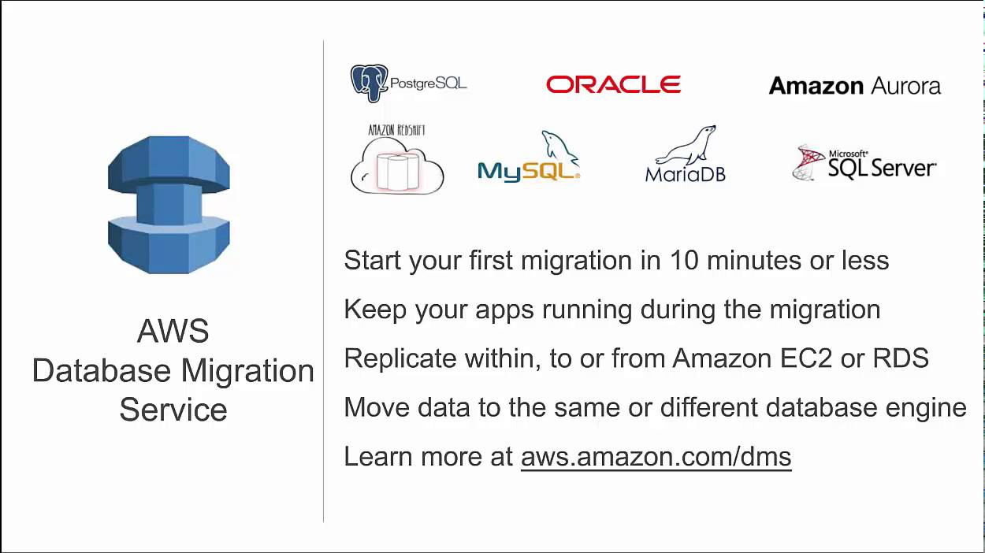
AWS DMS Overview

Slide 26
AWS Services related to AWS DMS
AWS RDS & Dynamo DB
AWS Snowball Edge
AWS Schema Conversion Tool
AWS RedShift
AWS CloudFormation (IAC) Services
AWS Migration Hub

Slide 27
Overview of Schema Conversion Tool
AWS Schema Conversion Tool (AWS SCT) converts your existing database schema from one database engine to another.
Used to convert relational OLTP schema, or data warehouse schema.
The converted schema can be used with used with a database on RDS, RedShift or an Amazon EC2 instance or stored as data on an Amazon S3 bucket.
AWS SCT supports several industry standards, including Federal Information Processing Standards (FIPS)

Slide 28
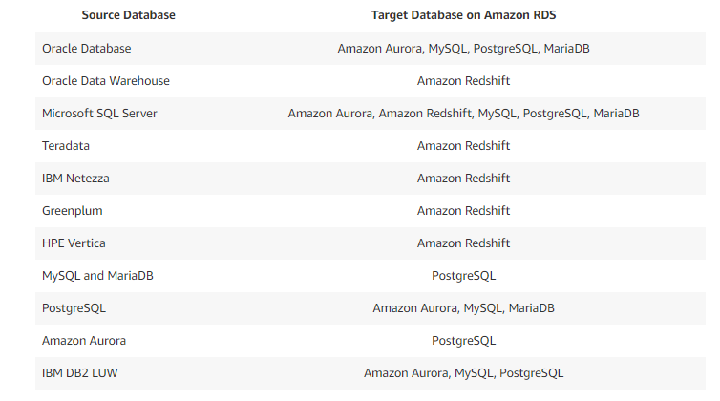
DB Conversions supported by SCT

Slide 29
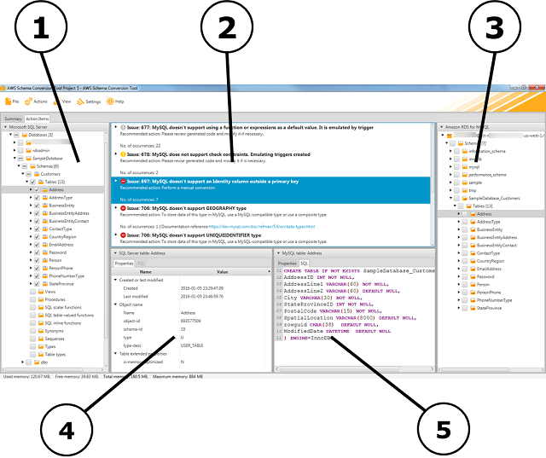
AWS SCT Project Window

Slide 30
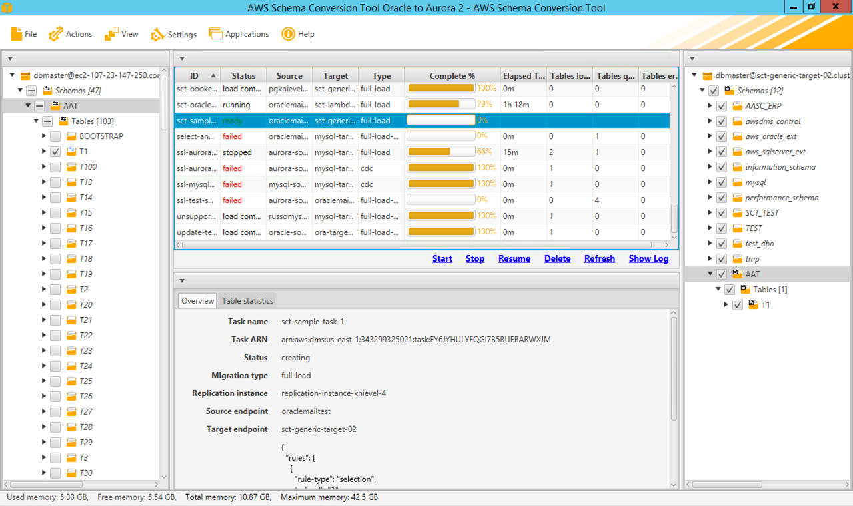
AWS Schema Conversion Tool (Oracle to Aurora2)

Slide 31
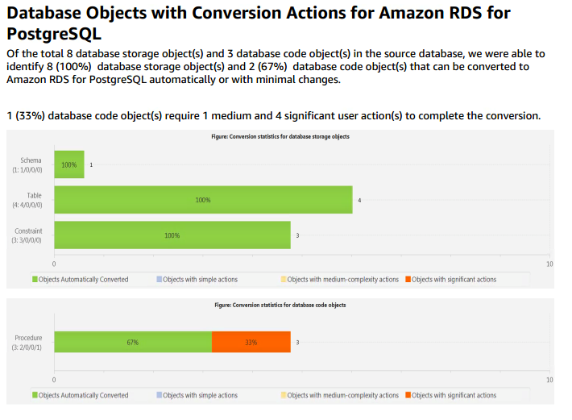
Sample SCT Service Report

Slide 32
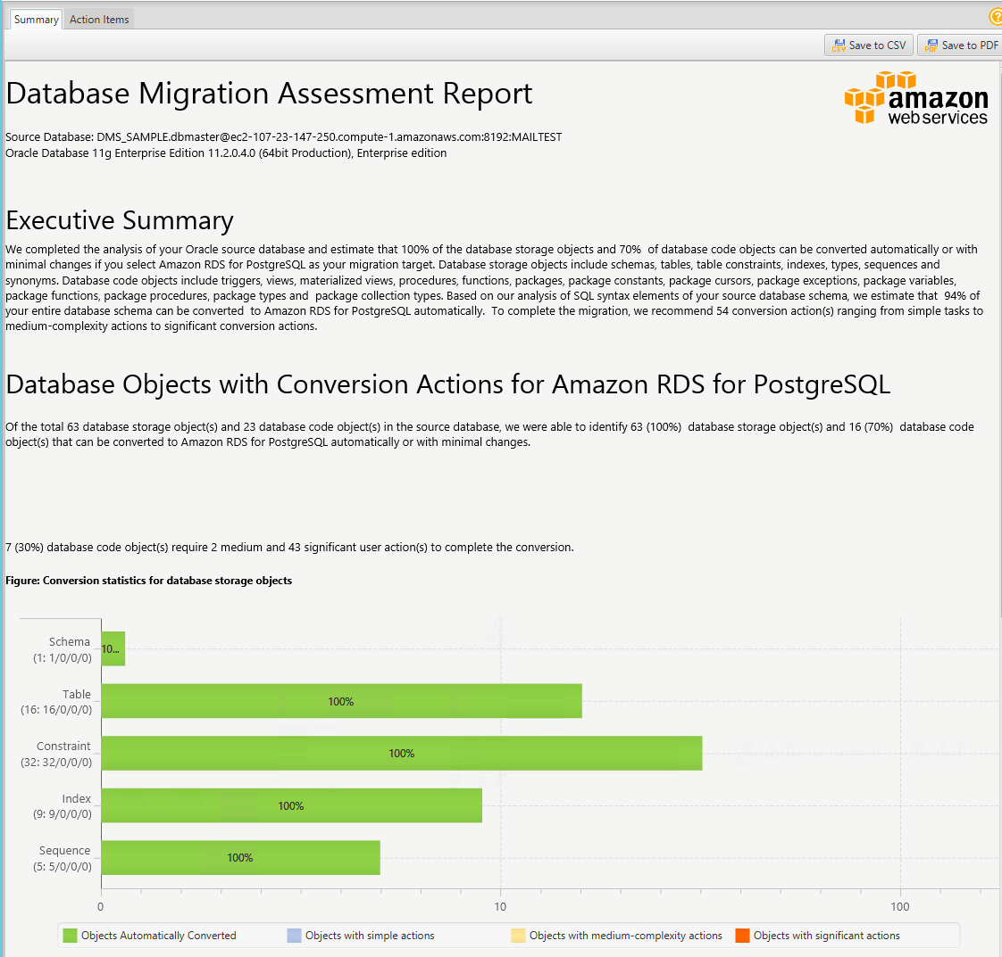
Sample SCT Service Report

Slide 33
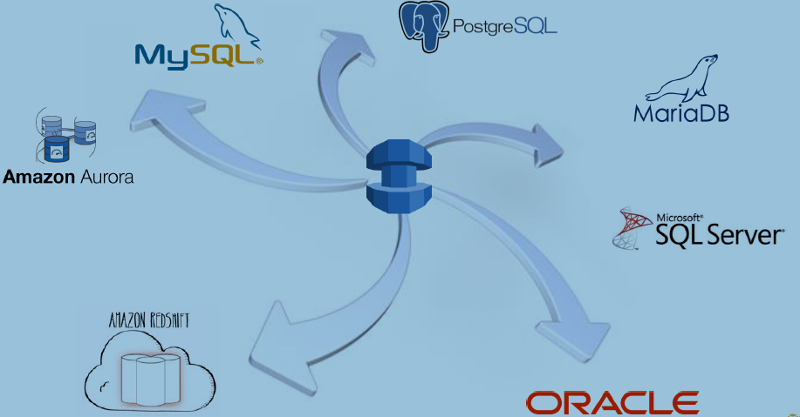
DB Migration Use Cases – From Source to Target

Slide 34
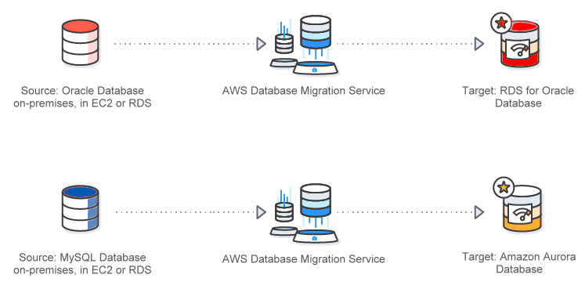
DB Migration Use Cases – Homogeneous
DB engine on both side are same
Amazon Aurora is a new developed DB engine which is fully managed, MySQL-compatible, relational database engine
Sources : https://aws.amazon.com/dms/

Slide 35
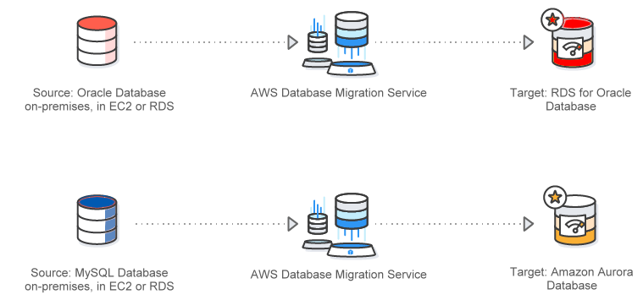
DB Migration Use Cases – Heterogeneous
Hetrogenous DB migration is a two Step Process
Step1: Schema and code transformation with AWS Schema conversion(SCT) tools
Step2: DB migration via AWS DB Migration services
Sources : https://aws.amazon.com/dms/

Slide 36
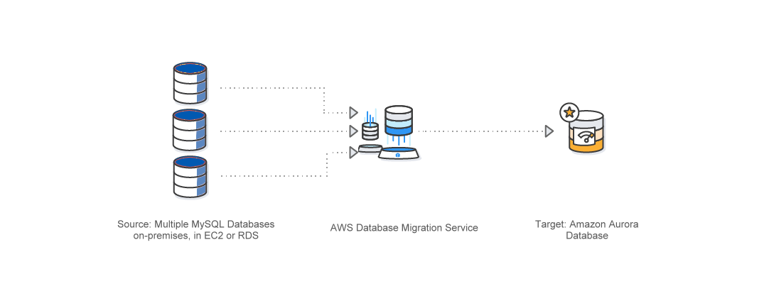
DB Migration Use Cases – DB Consolidation
Sources : https://aws.amazon.com/dms/

Slide 37
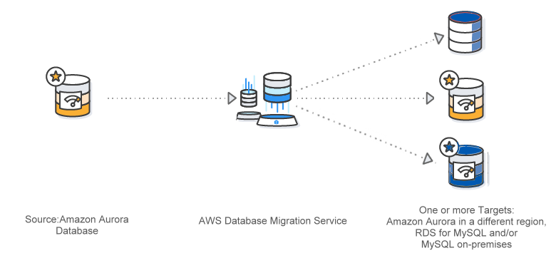
DB Migration Use Cases – Continuous Data Replication
Sources : https://aws.amazon.com/dms/

Slide 38
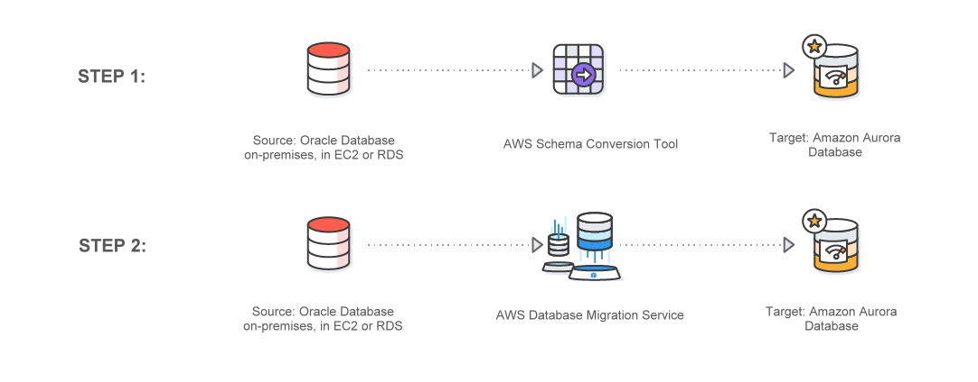
DMS & SCT Working together

Slide 39
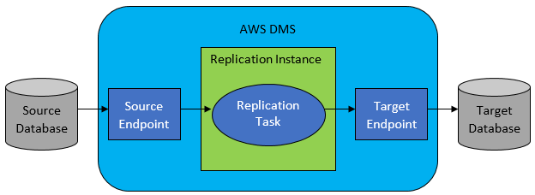
How Database Migration Service Works

Slide 40
How AWS DMS Works
Identify your source and target data stores. These data stores can reside on any of the data engines.
For both the source and target, configure endpoints within AWS DMS that specify the connection information to the databases. The endpoints use the appropriate ODBC drivers to communicate with your source and target.
Provision a replication instance, which is a server that AWS DMS automatically configures with replication software.
Create a replication task, which specifies the actual data tables to migrate and data transformation rules to apply. AWS DMS manages running the replication task and provides you status on the migration process.

Slide 41

AWS DMS Components
Replication Instance
Source Endpoint
Target
Endpoint
Tasks

Slide 42
AWS DMS Components
Replication instance: Replication instance (EC2) provides the compute resources you need for the migration. As with other AWS services, you have the freedom to choose which size fits your needs best. It also provides High Availability and fail-over capabilities.
Endpoints: Either called ‘source’ or ‘target’ endpoints, which specify the entry points to the database you are migrating from/to.
Tasks: Specify the endpoints you want to use for the migration, task settings which can be tuned for each type of migration, and table mappings which allow you to perform some additional modifications at schema, table or column level during the migration.

Slide 43
DB Migration to AWS – 3 Stages
AWS DB Migration process can be divided into 3 stages
Stage 1 - Pre migration
Stage 2 - Migration
Stage 3 - Post Migration

Slide 44
DB Migration to AWS – Stage 1
Learn all about all DB migration related Services
Identify and priorities DB’S which need to be migrated .First migrate those DB’S which have least dependencies
In case of heterogeneous migration , use SCT tool to get an advance report on DB Migration
SCT report can help in an early understanding of DB transformation complexity
Create your entire target stack using CloudFormation
Apply AWS well architecture framework on AWS target cloud Architecture

Slide 45
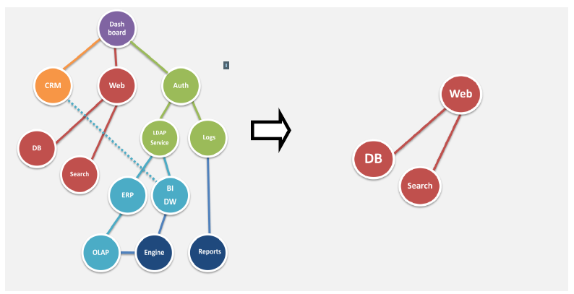
Identifying and Prioritizing DB’s for Migration
For identifying a right DB migration services, create a DB dependency graph as shown below

Slide 46
DB Migration to AWS – Stage 2
Run SCT in case of heterogeneous DB migration
Configure DMS for DB Migration
Initiate your DB Migration task
Use AWS Migration Hub to monitor all DB migration

Slide 47
Running SCT tool for Heterogeneous DB Migrations
Step 1 - Install SCT tools
Step 2 – Connect to your source DB
Step 3 – Connect to your Target DB
Step 4 – View the schema feedback report to understand the complexity of DB migration
Step 5 – Convert your schema from Source to Target
Step 6 – Apply your schema on target DB

Slide 48
DB Migration to AWS – Stage 3
Validate That all data has been migrated
Perform all post migration activities
Integrate your data with other AWS cloud services
Apply again well AWS architecture framework to further optimize your DB in Cloud

Slide 49
DMS Configuration
When using AWS DMS, the below steps must be followed
Create a replication server.
Create source and target endpoints that have connection information about your data stores
Create one or more tasks to migrate data between the source and target DB’S

Slide 50
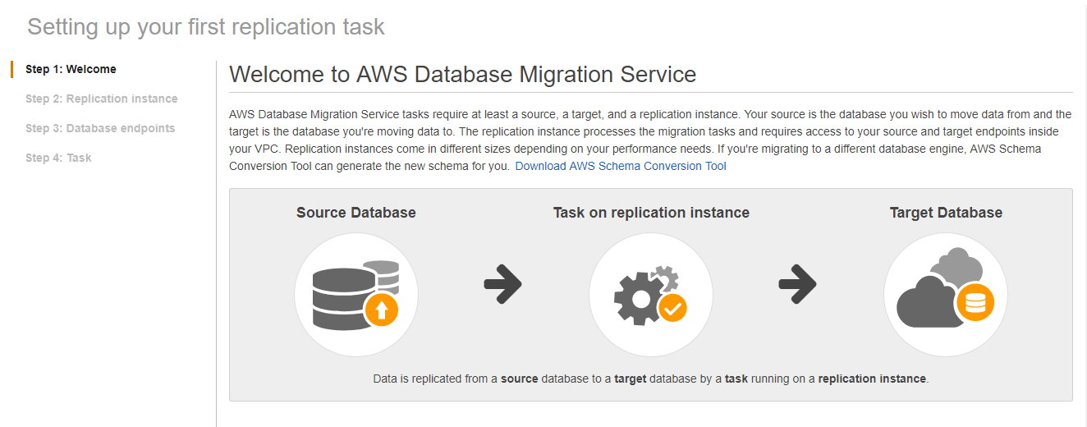
DMS Configuration Steps

Slide 51
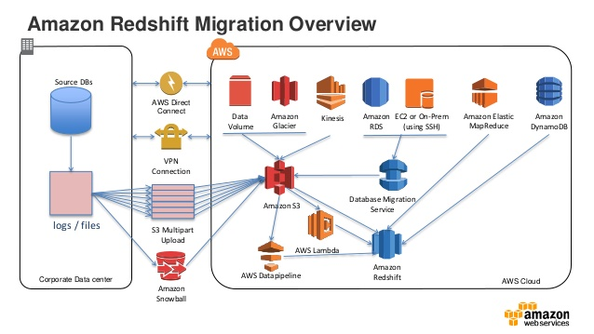
AWS Redshift Migration Architecture
Source: https://www.slideshare.net/AmazonWebServices/migrate-your-data-warehouse-to-amazon-redshift

Slide 52
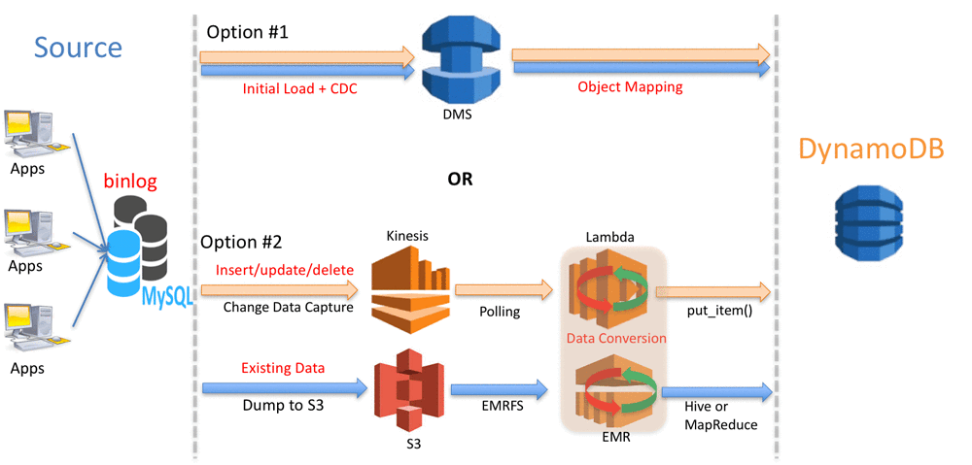
From RDS to AWS Dynamo DB Migration
https://aws.amazon.com/blogs/big-data/near-zero-downtime-migration-from-mysql-to-dynamodb/

Slide 53
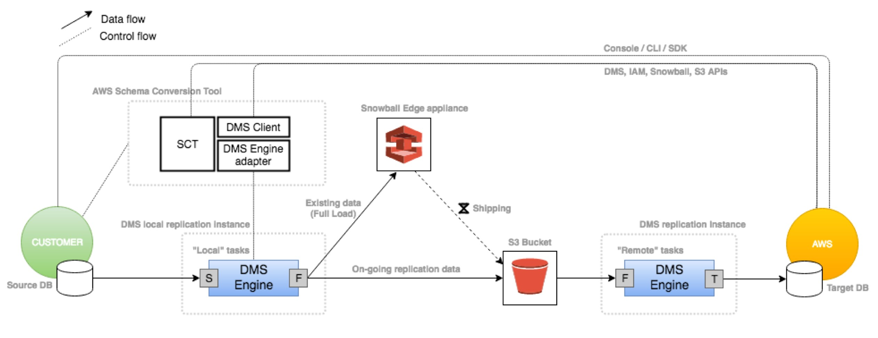
Use Case Mass DB Transfer To AWS Using Snowball edge
AWS snowball is both a service and a secure device
AWS Snowball can be used to transfer very large DB’s in the range of 100 TB via shipping logistic, with in two week
This can avoid issue like bandwidth limitation etc..
https://aws.amazon.com/blogs/database/new-aws-dms-and-aws-snowball-integration-enables-mass-database-migrations-and-migrations-of-large-databases/

Slide 54
Overview of DynamoDB
It is a fully managed NoSQL Database Service
Not to worry about maintenance or administration
Helps in creating databases that can restore any amount of data and serve any level of request traffic

Slide 55
Dynamo DB Benefits

Slide 56
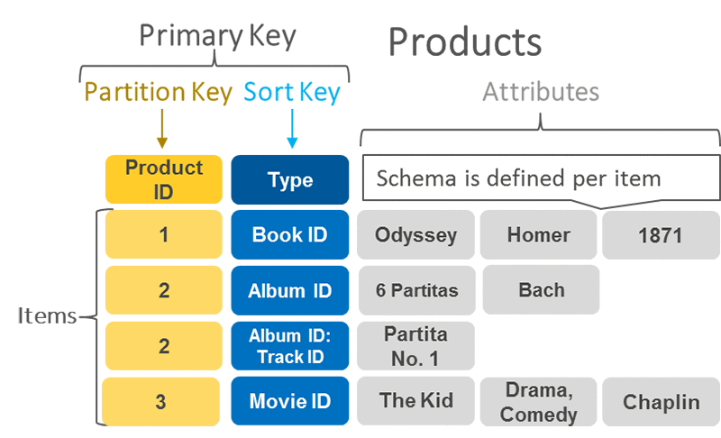
Working of DynamoDB

Slide 57
How DynamoDB works?
In DynamoDB, tables, items, and attributes are the core components that you work with.
A tableis a collection of items, and each item is a collection of attributes.
DynamoDB uses primary keys to uniquely identify each item in a table and secondary indexes to provide more querying flexibility.

Slide 58
Dynamo DB Streams
A DynamoDB stream is an ordered flow of information about changes to items in a DynamoDB table.
When you enable a stream on a table, DynamoDB captures information about every modification to data items in the table.
Whenever an application creates, updates, or deletes items in the table, DynamoDB Streams writes a stream record with the primary key attributes of the items that were modified.
A stream record contains information about a data modification to a single item in a DynamoDB table.
DynamoDB Streams helps ensure the following:
Each stream record appears exactly once in the stream.
For each item that is modified in a DynamoDB table, the stream records appear in the same sequence as the actual modifications to the item.
DynamoDB Streams writes stream records in near-real time so that you can build applications that consume these streams and take action based on the contents.

Slide 59
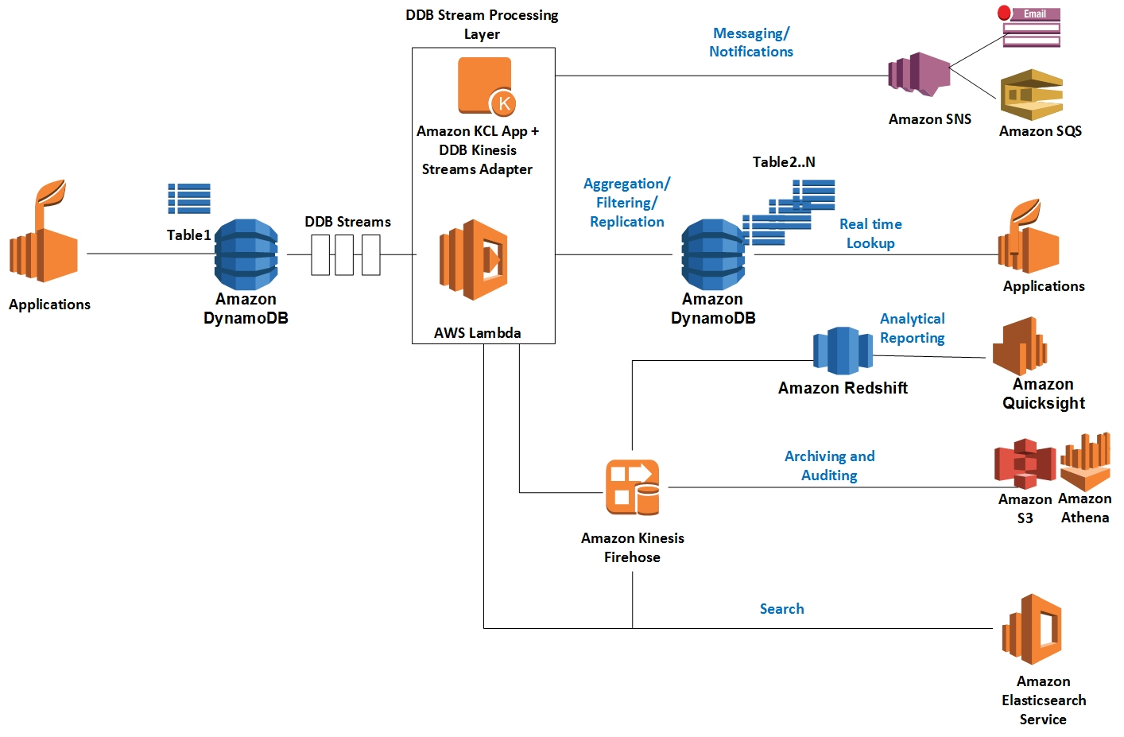
DynamoDB Streams design patterns (Reference Architecture)
Ref:https://aws.amazon.com/blogs/database/dynamodb-streams-use-cases-and-design-patterns/

Slide 60
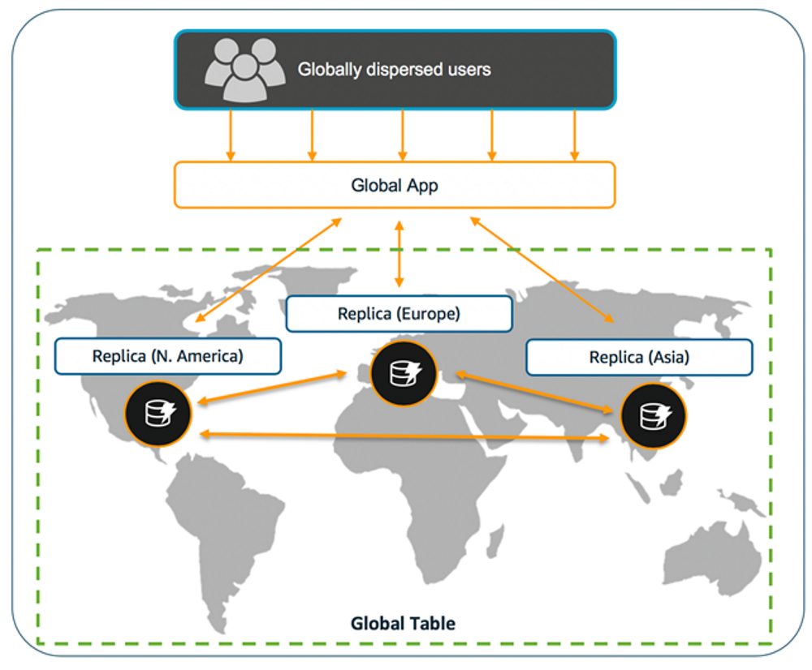
DynamoDB - Global Tables
Fully managed, multi-region, and multi-master database that delivers fast, local, read and write performance for massively scaled, global applications.
Replicates DynamoDB tables automatically across your choice of AWS Regions.
Eliminates the difficult work of replicating data between Regions and resolving update conflicts, enabling to focus on your application's business logic.
Consists of multiple replica tables (one per AWS Region) that DynamoDB treats as a single unit. Every replica has the same table name and the same primary key schema. When an application writes data to a replica table in one Region, DynamoDB propagates the write to the other replica tables in the other AWS Regions automatically.

Slide 61
Quiz
1.By default, DynamoDB is resilient on a __ basis. (Choose two answers)
Cross AZ
Global
Regional
2.In DynamoDB, what does the primary key contain? (Choose all that apply)
A partition key
Only a sort key
A hash key and a range key
3. In DynamoDB, what is the difference between a scan and a query operation?
There is no difference between scan and query because they both search through a table.
All of these answers are incorrect.
A scan will search the whole table, which uses more computing power. A query operation searches for only the primary key attributes, that are more efficient.
A scan will search only primary key attributes, which is more efficient. A query will search the whole table, which uses more computing power.

Slide 62
Overview of Elasticache
Web service that makes it easy to set up, manage, and scale a distributed in-memory data store or cache environment in the cloud.
Provides a high-performance, scalable, and cost-effective caching solution, while removing the complexity associated with deploying and managing a distributed cache environment.
Quickly deploy your cache environment, without having to provision hardware or install software.
Memcached or Redis protocol-compliant cache engine software

Slide 63
Working of Elasticache

Slide 64
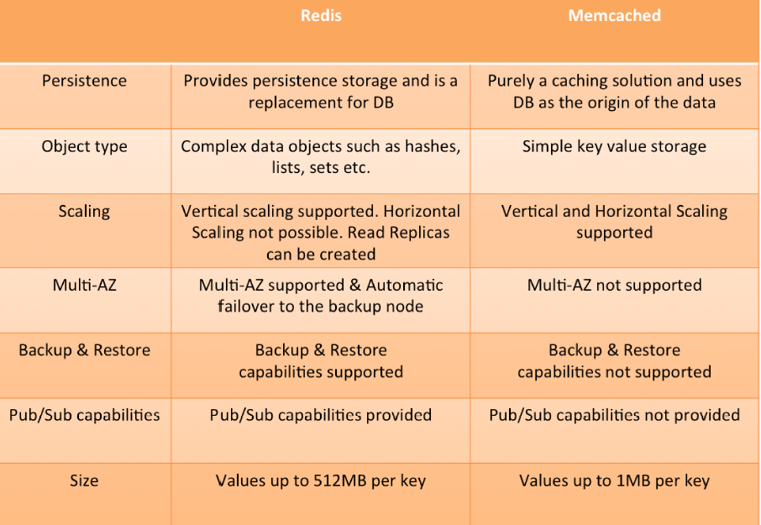
Redis vs Memcached

Slide 65
Thank You

